Slide 1
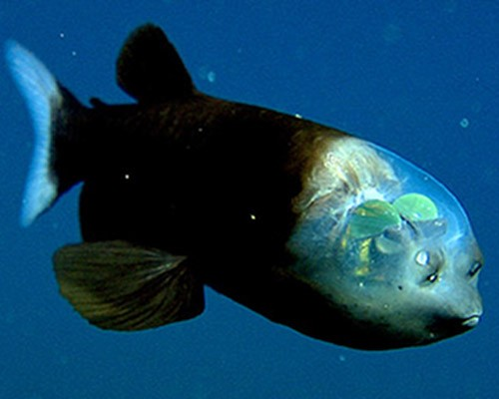
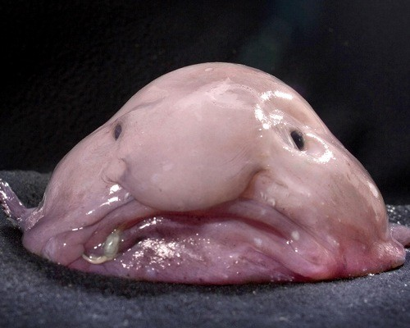
Barreleye vs. Blob
By:
Valeria Espinosa
Tasha Ghisays
Cristina Garcia

Slide 2
Description Barreleye fish
The Barreleye fish are about 6 inches. These deep-sea fish are found in water as deep as 3,330 ft (1015 m). Barreleye fish have been found in the Pacific Ocean, from the Bering Sea to Japan and Baja California, Mexico. The Barreleye fish have been researched for years, scientist think they eat jelly.

Slide 3
Description Blob fish
A blob fish is a fish that doesn’t have any muscles. It looks like a human face but when it is taken out of the water it dries out and loses its human- like face. They are also known as “Psychrolutes marcidus” and it is belonging to the Psychrolutidae or fathead Family. A Blob fish can grow up to 12 inches (30.5 cm) in length. . It lives 2,700 feet deep under water.

Slide 4
Piece of evidence

Slide 5
Piece of evidence

Slide 6
piece of evidence

Slide 7
AND THE WINNER IS….

Slide 8
Its obvious

Slide 9
DUHHHH

Slide 10

BARRELEYE FISH

Slide 11
Conclusion

Slide 12
Conclusion

Slide 13
CITATIONS
"11 Intriguing Transparent Animals: Barreleye." MNN. N.p., n.d. Web. 02 Sept. 2014. <http://www.mnn.com/earth-matters/animals/photos/11-intriguing-transparent-animals/barreleye>.
"Bone Broke." Bone Broke. N.p., n.d. Web. 02 Sept. 2014. <http://bonebrokeblog.wordpress.com/>.
"Interesting Facts." The Barreleye Fish. N.p., n.d. Web. 02 Sept. 2014. <http://thebarreleyefish.weebly.com/interesting-facts.html>.
"5 Facts About Blob Fish - Bubblews." Bubblews. N.p., n.d. Web. 02 Sept. 2014. <http://www.bubblews.com/news/262590-5-facts-about-blob-fish>

